Slide 1
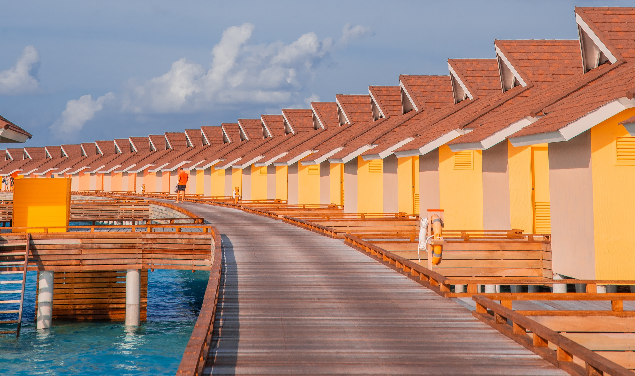
Introduction to Modern Controls
State-Space Realization Theory
State-Space Canonical Forms
1 / 40

Slide 2

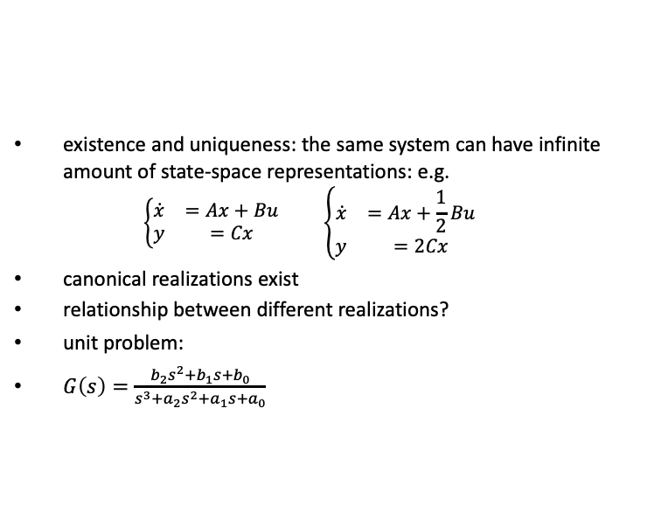
Goal
the realization problem:
?
$$\left[\begin{matrix}A & B \\ C & D\end{matrix}\right]$$
G (s) = ^{B(s)}
Σ =
A(s)
existence and uniqueness: the same system can have infinite amount of state-space representations: e.g.
$$\begin{matrix}\left\{\begin{matrix}\dot{x} & =Ax+Bu \\ y & =Cx\end{matrix}\right. & & \left\{\begin{matrix}\dot{x} & =Ax+\frac{1}{2}Bu \\ y & =2Cx\end{matrix}\right.\end{matrix}$$
canonical realizations exist
relationship between different realizations?
unit problem:
$G\left(s\right)=\frac{b_{2}s^{2}+b_{1}s+b_{0}}{s^{3}+a_{2}s^{2}+a_{1}s+a_{0}}$
State-Space Canonical Forms
3 / 40

Slide 3
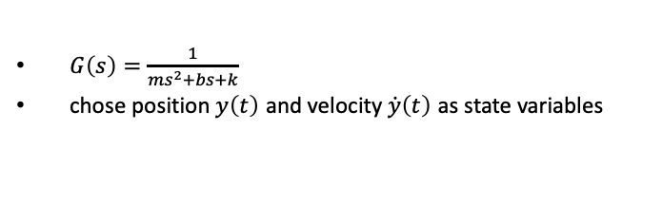
Recall
position: y(t)
k
u = F
b
m
$G\left(s\right)=\frac{1}{ms^{2}+bs+k}$
chose position $y\left(t\right)$ and velocity $\dot{y}\left(t\right)$ as state variables
State-Space Canonical Forms

Slide 4

From spring mass damper to modules with unity numerator
u
1
s³+a₂s²+a₁s+a₀
y
choose similarly:
$x_{1}=y, x_{2}={\dot{x}}_{1}=\dot{y}, x_{3}={\dot{x}}_{2}=\ddot{y}$
$⇒$
$$\begin{matrix}\frac{d}{dt}\left[\begin{matrix}x_{1} \\ x_{2} \\ x_{3}\end{matrix}\right] & =\left[\begin{matrix}0 & 1 & 0 \\ 0 & 0 & 1 \\ −a_{0} & −a_{1} & −a_{2}\end{matrix}\right]\left[\begin{matrix}x_{1} \\ x_{2} \\ x_{3}\end{matrix}\right]+\left[\begin{matrix}0 \\ 0 \\ 1\end{matrix}\right]u \\ y & =\left[\begin{matrix}1 & 0 & 0\end{matrix}\right]\left[\begin{matrix}x_{1} \\ x_{2} \\ x_{3}\end{matrix}\right]\end{matrix}$$
State-Space Canonical Forms

Slide 5


Controllable canonical form (ccf)
u
1
s³+a₂s²+a₁s+a₀
y
choose x₁ such that
1
s³+a₂s²+a₁s+a₀
$$x_{1}$$
u
b₂s² + b₁s + b₀
y
the first part
1
s³ + a₂s² + a₁s + a₀
u
$$\tilde{y}\left(=x_{1}\right)$$
is now familiar
State-Space Canonical Forms

Slide 6
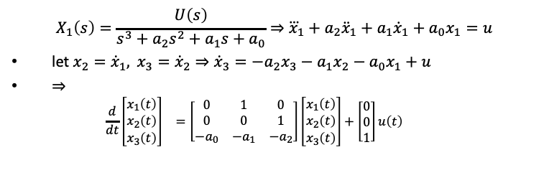
Controllable canonical form (ccf)
1
s³+a₂s²+a₁s+a₀
$$x_{1}$$
u
b₂s² + b₁s + b₀
y
$$X_{1}\left(s\right)=\frac{U\left(s\right)}{s^{3}+a_{2}s^{2}+a_{1}s+a_{0}}⇒{\overset{⃛}{x}}_{1}+a_{2}{\ddot{x}}_{1}+a_{1}{\dot{x}}_{1}+a_{0}x_{1}=u$$
let $x_{2}={\dot{x}}_{1}, x_{3}={\dot{x}}_{2}$ $⇒$ ${\dot{x}}_{3}=−a_{2}x_{3}−a_{1}x_{2}−a_{0}x_{1}+u$
$⇒$
$$\begin{matrix}\frac{d}{dt}\left[\begin{matrix}x_{1}\left(t\right) \\ x_{2}\left(t\right) \\ x_{3}\left(t\right)\end{matrix}\right] & =\left[\begin{matrix}0 & 1 & 0 \\ 0 & 0 & 1 \\ −a_{0} & −a_{1} & −a_{2}\end{matrix}\right]\left[\begin{matrix}x_{1}\left(t\right) \\ x_{2}\left(t\right) \\ x_{3}\left(t\right)\end{matrix}\right]+\left[\begin{matrix}0 \\ 0 \\ 1\end{matrix}\right]u\left(t\right)\end{matrix}$$
State-Space Canonical Forms

Slide 7
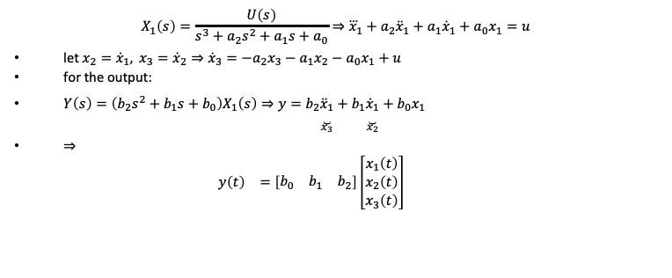
Controllable canonical form (ccf)
1
s³+a₂s²+a₁s+a₀
$$x_{1}$$
u
b₂s² + b₁s + b₀
y
$$X_{1}\left(s\right)=\frac{U\left(s\right)}{s^{3}+a_{2}s^{2}+a_{1}s+a_{0}}⇒{\overset{⃛}{x}}_{1}+a_{2}{\ddot{x}}_{1}+a_{1}{\dot{x}}_{1}+a_{0}x_{1}=u$$
let $x_{2}={\dot{x}}_{1}, x_{3}={\dot{x}}_{2}$ $⇒$ ${\dot{x}}_{3}=−a_{2}x_{3}−a_{1}x_{2}−a_{0}x_{1}+u$
for the output:
$Y\left(s\right)=\left(b_{2}s^{2}+b_{1}s+b_{0}\right)X_{1}\left(s\right)⇒y=b_{2}\underset{x_{3}}{\underset{⏟}{{\ddot{x}}_{1}}}+b_{1}\underset{x_{2}}{\underset{⏟}{{\dot{x}}_{1}}}+b_{0}x_{1}$
$⇒$
$$\begin{matrix}y\left(t\right) & =\left[\begin{matrix}b_{0} & b_{1} & b_{2}\end{matrix}\right]\left[\begin{matrix}x_{1}\left(t\right) \\ x_{2}\left(t\right) \\ x_{3}\left(t\right)\end{matrix}\right]\end{matrix}$$
State-Space Canonical Forms

Slide 8
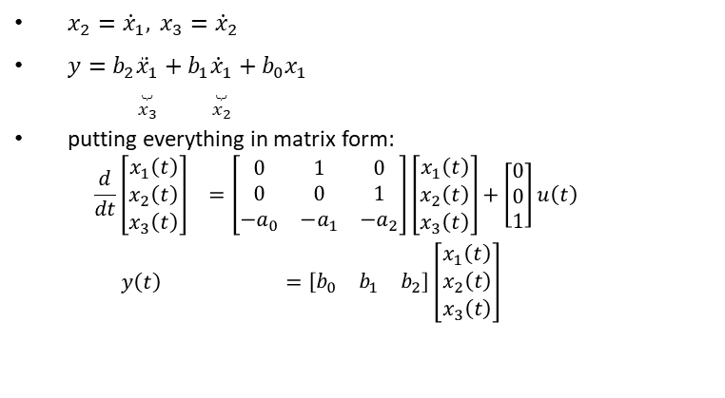
Controllable canonical form (ccf)
1
s³+a₂s²+a₁s+a₀
$$x_{1}$$
u
b₂s² + b₁s + b₀
y
$x_{2}={\dot{x}}_{1}, x_{3}={\dot{x}}_{2}$
$y=b_{2}\underset{x_{3}}{\underset{⏟}{{\ddot{x}}_{1}}}+b_{1}\underset{x_{2}}{\underset{⏟}{{\dot{x}}_{1}}}+b_{0}x_{1}$
putting everything in matrix form:
$$\begin{matrix}\frac{d}{dt}\left[\begin{matrix}x_{1}\left(t\right) \\ x_{2}\left(t\right) \\ x_{3}\left(t\right)\end{matrix}\right] & =\left[\begin{matrix}0 & 1 & 0 \\ 0 & 0 & 1 \\ −a_{0} & −a_{1} & −a_{2}\end{matrix}\right]\left[\begin{matrix}x_{1}\left(t\right) \\ x_{2}\left(t\right) \\ x_{3}\left(t\right)\end{matrix}\right]+\left[\begin{matrix}0 \\ 0 \\ 1\end{matrix}\right]u\left(t\right) \\ y\left(t\right) & =\left[\begin{matrix}b_{0} & b_{1} & b_{2}\end{matrix}\right]\left[\begin{matrix}x_{1}\left(t\right) \\ x_{2}\left(t\right) \\ x_{3}\left(t\right)\end{matrix}\right]\end{matrix}$$
State-Space Canonical Forms

Slide 9
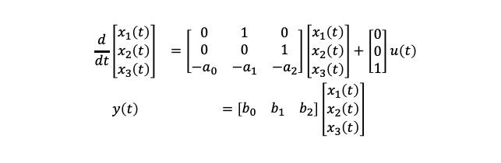
Block diagram realization of ccf
$$\begin{matrix}\frac{d}{dt}\left[\begin{matrix}x_{1}\left(t\right) \\ x_{2}\left(t\right) \\ x_{3}\left(t\right)\end{matrix}\right] & =\left[\begin{matrix}0 & 1 & 0 \\ 0 & 0 & 1 \\ −a_{0} & −a_{1} & −a_{2}\end{matrix}\right]\left[\begin{matrix}x_{1}\left(t\right) \\ x_{2}\left(t\right) \\ x_{3}\left(t\right)\end{matrix}\right]+\left[\begin{matrix}0 \\ 0 \\ 1\end{matrix}\right]u\left(t\right) \\ y\left(t\right) & =\left[\begin{matrix}b_{0} & b_{1} & b_{2}\end{matrix}\right]\left[\begin{matrix}x_{1}\left(t\right) \\ x_{2}\left(t\right) \\ x_{3}\left(t\right)\end{matrix}\right]\end{matrix}$$
b2
+
b1
U(s)
+
X3
X2
X1
+
Y(s)
1
s
1
s
1
s
b0
−
+
a2
+
a1
a0
State-Space Canonical Forms

Slide 10
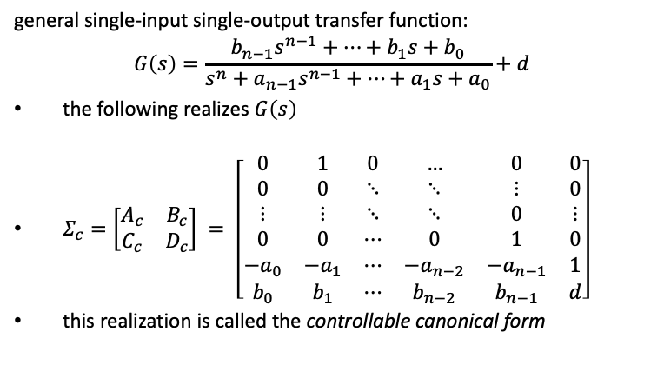
General ccf
general single-input single-output transfer function:
$$G\left(s\right)=\frac{b_{n−1}s^{n−1}+⋯+b_{1}s+b_{0}}{s^{n}+a_{n−1}s^{n−1}+⋯+a_{1}s+a_{0}}+d$$
the following realizes $G\left(s\right)$
$Σ_{c}=\left[\begin{matrix}A_{c} & B_{c} \\ C_{c} & D_{c}\end{matrix}\right] = \left[\begin{matrix}0 & 1 & 0 & … & 0 & 0 \\ 0 & 0 & ⋱ & ⋱ & ⋮ & 0 \\ ⋮ & ⋮ & ⋱ & ⋱ & 0 & ⋮ \\ 0 & 0 & ⋯ & 0 & 1 & 0 \\ −a_{0} & −a_{1} & ⋯ & −a_{n−2} & −a_{n−1} & 1 \\ b_{0} & b_{1} & ⋯ & b_{n−2} & b_{n−1} & d\end{matrix}\right]$
this realization is called the controllable canonical form
State-Space Canonical Forms

Slide 11
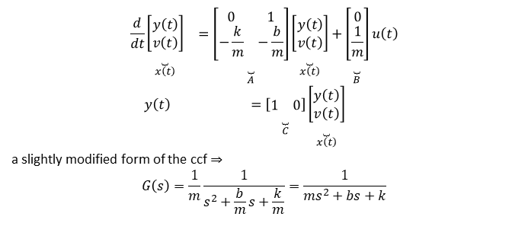
ccf example
k
position: y(t)
u = F
b
m
$$\begin{matrix}\frac{d}{dt}\underset{x\left(t\right)}{\underset{⏟}{\left[\begin{matrix}y\left(t\right) \\ v\left(t\right)\end{matrix}\right]}} & =\underset{A}{\underset{⏟}{\left[\begin{matrix}0 & 1 \\ −\frac{k}{m} & −\frac{b}{m}\end{matrix}\right]}}\underset{x\left(t\right)}{\underset{⏟}{\left[\begin{matrix}y\left(t\right) \\ v\left(t\right)\end{matrix}\right]}}+\underset{B}{\underset{⏟}{\left[\begin{matrix}0 \\ \frac{1}{m}\end{matrix}\right]}}u\left(t\right) \\ y\left(t\right) & =\underset{C}{\underset{⏟}{\left[\begin{matrix}1 & 0\end{matrix}\right]}}\underset{x\left(t\right)}{\underset{⏟}{\left[\begin{matrix}y\left(t\right) \\ v\left(t\right)\end{matrix}\right]}}\end{matrix}$$
a slightly modified form of the ccf $⇒$
$$G\left(s\right)=\frac{1}{m}\frac{1}{s^{2}+\frac{b}{m}s+\frac{k}{m}}=\frac{1}{ms^{2}+bs+k}$$
State-Space Canonical Forms

Slide 12

Observable canonical form (ocf)
$$\begin{matrix}Y\left(s\right) & =\frac{b_{2}s^{2}+b_{1}s+b_{0}}{s^{3}+a_{2}s^{2}+a_{1}s+a_{0}}U\left(s\right) \\ ⇒Y\left(s\right) & =−\frac{a_{2}}{s}Y\left(s\right)−\frac{a_{1}}{s^{2}}Y\left(s\right)−\frac{a_{0}}{s^{3}}Y\left(s\right)+\frac{b_{2}}{s}U\left(s\right)+\frac{b_{1}}{s^{2}}U\left(s\right)+\frac{b_{0}}{s^{3}}U\left(s\right)\end{matrix}$$
in a block diagram, the above looks like
b₂
b₁
U(s)
+
1
+
1
+
1
s
Y(s)
b₀
s
s
−
−
−
a₂
a₁
a₀
State-Space Canonical Forms

Slide 13
Observable canonical form
b2
b1
U(s)
+
X3
+
+
Y(s)
b
1
s
1
s
X2
1
s
X1
0
−
−
−
a2
a1
a0
here, the states are connected by
Y(s) = X₁(s)
sX₁(s) = −a₂X₁(s) + X₂(s) + b₂U(s) sX₂(s) = −a₁X₁(s) + X₃(s) + b₁U(s) sX₃(s) = −a₀X₁(s) + b₀U(s)
y(t) = x₁(t)
x˙₁(t) = −a₂x₁(t) + x₂(t) + b₂u(t)
⇒ x˙₂(t) = −a₁x₁(t) + x₃(t) + b₁u(t) x˙₃(t) = −a₀x₁(t) + b₀u(t)
State-Space Canonical Forms

Slide 14
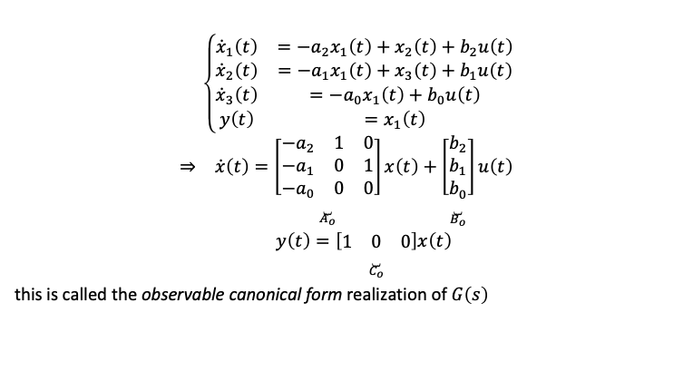
Observable canonical form
$$\begin{matrix} & \left\{\begin{matrix}{\dot{x}}_{1}\left(t\right) & =−a_{2}x_{1}\left(t\right)+x_{2}\left(t\right)+b_{2}u\left(t\right) \\ {\dot{x}}_{2}\left(t\right) & =−a_{1}x_{1}\left(t\right)+x_{3}\left(t\right)+b_{1}u\left(t\right) \\ {\dot{x}}_{3}\left(t\right) & =−a_{0}x_{1}\left(t\right)+b_{0}u\left(t\right) \\ y\left(t\right) & =x_{1}\left(t\right)\end{matrix}\right.\end{matrix}$$
$$\begin{matrix}⇒ & \dot{x}\left(t\right)=\underset{A_{o}}{\underset{⏟}{\left[\begin{matrix}−a_{2} & 1 & 0 \\ −a_{1} & 0 & 1 \\ −a_{0} & 0 & 0\end{matrix}\right]}}x\left(t\right)+\underset{B_{o}}{\underset{⏟}{\left[\begin{matrix}b_{2} \\ b_{1} \\ b_{0}\end{matrix}\right]}}u\left(t\right) \\ & y\left(t\right)=\underset{C_{o}}{\underset{⏟}{\left[\begin{matrix}1 & 0 & 0\end{matrix}\right]}}x\left(t\right)\end{matrix}$$
this is called the observable canonical form realization of $G\left(s\right)$
State-Space Canonical Forms

Slide 15
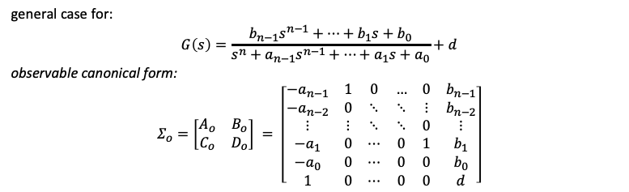
General ocf
general case for:
$$G\left(s\right)=\frac{b_{n−1}s^{n−1}+⋯+b_{1}s+b_{0}}{s^{n}+a_{n−1}s^{n−1}+⋯+a_{1}s+a_{0}}+d$$
observable canonical form:
$$Σ_{o}=\left[\begin{matrix}A_{o} & B_{o} \\ C_{o} & D_{o}\end{matrix}\right] = \left[\begin{matrix}−a_{n−1} & 1 & 0 & … & 0 & b_{n−1} \\ −a_{n−2} & 0 & ⋱ & ⋱ & ⋮ & b_{n−2} \\ ⋮ & ⋮ & ⋱ & ⋱ & 0 & ⋮ \\ −a_{1} & 0 & ⋯ & 0 & 1 & b_{1} \\ −a_{0} & 0 & ⋯ & 0 & 0 & b_{0} \\ 1 & 0 & ⋯ & 0 & 0 & d\end{matrix}\right]$$
State-Space Canonical Forms

Slide 16
ocf in Python
import control as ct
Gs = ct.tf2ss([1,0,1],[1,2,10])
Gc, T = ct.canonical_form(Gs,'observable')
Gc.A Gc.B Gc.C Gc.D
ccf and ocf: no direct Matlab commands
State-Space Canonical Forms

Slide 17
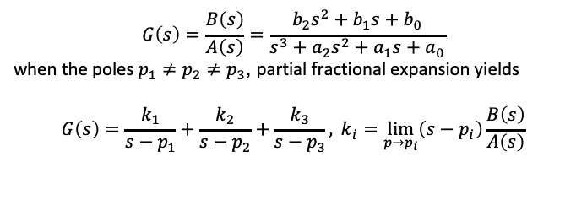
Diagonal form
$$G\left(s\right)=\frac{B\left(s\right)}{A\left(s\right)}=\frac{b_{2}s^{2}+b_{1}s+b_{0}}{s^{3}+a_{2}s^{2}+a_{1}s+a_{0}}$$
when the poles $p_{1}≠p_{2}≠p_{3}$, partial fractional expansion yields
$$G\left(s\right)=\frac{k_{1}}{s−p_{1}}+\frac{k_{2}}{s−p_{2}}+\frac{k_{3}}{s−p_{3}}, k_{i}=\lim_{p→p_{i}}\left(s−p_{i}\right)\frac{B\left(s\right)}{A\left(s\right)}$$
+ sX₁
+
1
s
X₁
k₁
p₁
U(s)
+ sX₂
X₂
+ Y(s)
1
s
k₂
+
+
p₂
+ sX₃
1
s
X₃
k₃
+
p₃
State-Space Canonical Forms
21 / 40

Slide 18
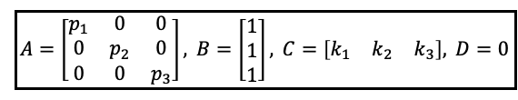
Diagonal form
+ sX₁
1
s
X₁
k₁
+
p₁
U(s)
+ Y(s)
+ sX₂
1
s
X₂
k₂
+
+
p₂
+ sX₃
1
s
X₃
k₃
+
p₃
state-space realization:
$$\boxed{A=\left[\begin{matrix}p_{1} & 0 & 0 \\ 0 & p_{2} & 0 \\ 0 & 0 & p_{3}\end{matrix}\right], B=\left[\begin{matrix}1 \\ 1 \\ 1\end{matrix}\right], C=\left[\begin{matrix}k_{1} & k_{2} & k_{3}\end{matrix}\right], D=0}$$
State-Space Canonical Forms

Slide 19
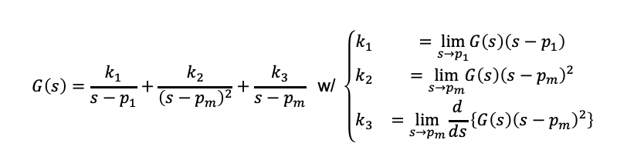
Jordan form
if poles repeat, say,
$$G\left(s\right)=\frac{b_{2}s^{2}+b_{1}s+b_{0}}{s^{3}+a_{2}s^{2}+a_{1}s+a_{0}}=\frac{b_{2}s^{2}+b_{1}s+b_{0}}{\left(s−p_{1}\right){\left(s−p_{m}\right)}^{2}}, p_{1}≠p_{m}∈ℝ$$
then partial fraction expansion gives
$$G\left(s\right)=\frac{k_{1}}{s−p_{1}}+\frac{k_{2}}{{\left(s−p_{m}\right)}^{2}}+\frac{k_{3}}{s−p_{m}} \text{w}\text{/ }\left\{\begin{matrix}k_{1} & =\lim_{s→p_{1}}G\left(s\right)\left(s−p_{1}\right) \\ k_{2} & =\lim_{s→p_{m}}G\left(s\right){\left(s−p_{m}\right)}^{2} \\ k_{3} & =\lim_{s→p_{m}}\frac{d}{ds}\left\{G\left(s\right){\left(s−p_{m}\right)}^{2}\right\}\end{matrix}\right.$$
State-Space Canonical Forms

Slide 20
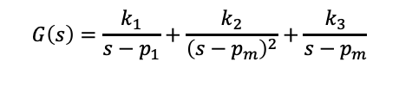
Jordan form
$$G\left(s\right)=\frac{k_{1}}{s−p_{1}}+\frac{k_{2}}{{\left(s−p_{m}\right)}^{2}}+\frac{k_{3}}{s−p_{m}}$$
has the block diagram realization:
+ X₁
1
s
k₁
+
p₁
U(s)
+ Y(s)
k₃
+
+
1
s
X₃ +
1
s
X₂
k₂
+
+
p_{m}
p_{m}
State-Space Canonical Forms

Slide 21
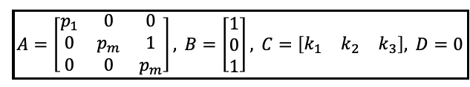
Jordan form
+
1
s
X₁
k₁
+
p₁
U(s)
+ Y(s)
k₃
+
+
1
s
X₃ +
1
s
X₂
k₂
+
+
p_{m} p_{m}
state-space realization (called the Jordan canonical form):
$$\boxed{A=\left[\begin{matrix}p_{1} & 0 & 0 \\ 0 & p_{m} & 1 \\ 0 & 0 & p_{m}\end{matrix}\right], B=\left[\begin{matrix}1 \\ 0 \\ 1\end{matrix}\right], C=\left[\begin{matrix}k_{1} & k_{2} & k_{3}\end{matrix}\right], D=0}$$
State-Space Canonical Forms

Slide 22
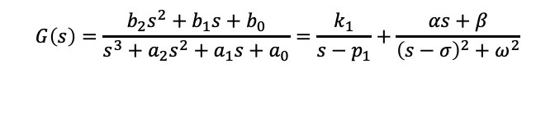

Modified canonical form
if the system has complex poles, say,
$$G\left(s\right)=\frac{b_{2}s^{2}+b_{1}s+b_{0}}{s^{3}+a_{2}s^{2}+a_{1}s+a_{0}}=\frac{k_{1}}{s−p_{1}}+\frac{αs+β}{{\left(s−σ\right)}^{2}+ω^{2}}$$
then
+
1
s
X₁
k₁
+
p₁
U(s)
Y(s)
k₃
+
+
+
1
s
X₃
ω
+
1
s
X₂
k₂
+
+
+
σ
σ
−
ω
where $k_{2}=\left(β+ασ\right)/ω$ and $k_{3}=α$
State-Space Canonical Forms

Slide 23
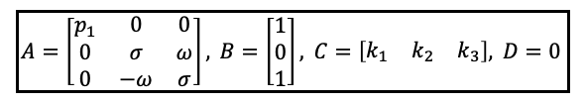
Modified canonical form
+
1
s
X₁
k₁
+
p₁
U(s)
Y(s)
k₃
+
+
+
1
s
X₃
ω
+
1
s
X₂
k₂
+
+
+
σ
σ
−
ω
⇒ modified Jordan form:
$$\boxed{A=\left[\begin{matrix}p_{1} & 0 & 0 \\ 0 & σ & ω \\ 0 & −ω & σ\end{matrix}\right], B=\left[\begin{matrix}1 \\ 0 \\ 1\end{matrix}\right], C=\left[\begin{matrix}k_{1} & k_{2} & k_{3}\end{matrix}\right], D=0}$$
State-Space Canonical Forms

Slide 24
State-Space Canonical Forms
29 / 40

Slide 25
?
Transfer function
State space
Easy
State-Space Canonical Forms
29 / 40

Slide 26
Continuous- and discrete-time state-space descriptions
System
_{y}
u
x₁,x₂,...,xn
x(0)=0
x˙(t) = Ax(t) + Bu(t)
y(t) = Cx(t) + Du(t)
sX(s) = AX(s) + BU(s)
Y(s) = CX(s) + DU(s)
x(k + 1) = Ax(k) + Bu(k)
y(k) = Cx(k) + Du(k)
zX(z) = AX(z) + BU(z)
Y(z) = CX(z) + DU(z)
previous procedure applies to discrete-time systems replace t with k, and x˙(t) with x(k + 1)
replace s with z, and
1
with
_{Z} −1
in block diagrams
s
State-Space Canonical Forms

Slide 27
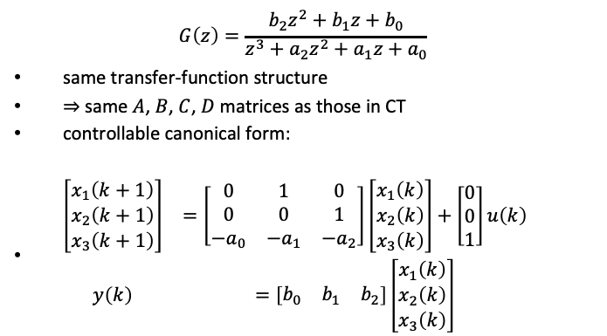
DT controllable canonical form
$$G\left(z\right)=\frac{b_{2}z^{2}+b_{1}z+b_{0}}{z^{3}+a_{2}z^{2}+a_{1}z+a_{0}}$$
same transfer-function structure
$⇒$ same $A$, $B$, $C$, $D$ matrices as those in CT
controllable canonical form:
$\begin{matrix}\left[\begin{matrix}x_{1}\left(k+1\right) \\ x_{2}\left(k+1\right) \\ x_{3}\left(k+1\right)\end{matrix}\right] & =\left[\begin{matrix}0 & 1 & 0 \\ 0 & 0 & 1 \\ −a_{0} & −a_{1} & −a_{2}\end{matrix}\right]\left[\begin{matrix}x_{1}\left(k\right) \\ x_{2}\left(k\right) \\ x_{3}\left(k\right)\end{matrix}\right]+\left[\begin{matrix}0 \\ 0 \\ 1\end{matrix}\right]u\left(k\right) \\ y\left(k\right) & =\left[\begin{matrix}b_{0} & b_{1} & b_{2}\end{matrix}\right]\left[\begin{matrix}x_{1}\left(k\right) \\ x_{2}\left(k\right) \\ x_{3}\left(k\right)\end{matrix}\right]\end{matrix}$
State-Space Canonical Forms

Slide 28

DT controllable canonical form
$$G\left(z\right)=\frac{b_{2}z^{2}+b_{1}z+b_{0}}{z^{3}+a_{2}z^{2}+a_{1}z+a_{0}}$$
b2
+
b1
U(z)
+
X3
X2
X1
+
Y(z)
_{z}−1
_{z}−1
_{z}−1
b0
−
+
a2
+
a1
a0
State-Space Canonical Forms

Slide 29
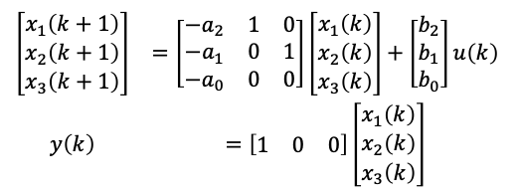
DT observable canonical form
$$G\left(z\right)=\frac{b_{2}z^{2}+b_{1}z+b_{0}}{z^{3}+a_{2}z^{2}+a_{1}z+a_{0}}$$
observable canonical form:
$$\begin{matrix}\left[\begin{matrix}x_{1}\left(k+1\right) \\ x_{2}\left(k+1\right) \\ x_{3}\left(k+1\right)\end{matrix}\right] & =\left[\begin{matrix}−a_{2} & 1 & 0 \\ −a_{1} & 0 & 1 \\ −a_{0} & 0 & 0\end{matrix}\right]\left[\begin{matrix}x_{1}\left(k\right) \\ x_{2}\left(k\right) \\ x_{3}\left(k\right)\end{matrix}\right]+\left[\begin{matrix}b_{2} \\ b_{1} \\ b_{0}\end{matrix}\right]u\left(k\right) \\ y\left(k\right) & =\left[\begin{matrix}1 & 0 & 0\end{matrix}\right]\left[\begin{matrix}x_{1}\left(k\right) \\ x_{2}\left(k\right) \\ x_{3}\left(k\right)\end{matrix}\right]\end{matrix}$$
State-Space Canonical Forms

Slide 30
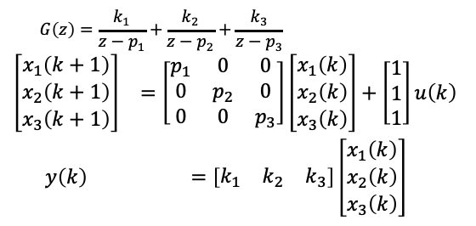
DT diagonal form
$$G\left(z\right)=\frac{b_{2}z^{2}+b_{1}z+b_{0}}{z^{3}+a_{2}z^{2}+a_{1}z+a_{0}}$$
diagonal form (distinct poles):
$$G\left(z\right)=\frac{k_{1}}{z−p_{1}}+\frac{k_{2}}{z−p_{2}}+\frac{k_{3}}{z−p_{3}}$$
$$\begin{matrix}\left[\begin{matrix}x_{1}\left(k+1\right) \\ x_{2}\left(k+1\right) \\ x_{3}\left(k+1\right)\end{matrix}\right] & =\left[\begin{matrix}p_{1} & 0 & 0 \\ 0 & p_{2} & 0 \\ 0 & 0 & p_{3}\end{matrix}\right]\left[\begin{matrix}x_{1}\left(k\right) \\ x_{2}\left(k\right) \\ x_{3}\left(k\right)\end{matrix}\right]+\left[\begin{matrix}1 \\ 1 \\ 1\end{matrix}\right]u\left(k\right) \\ y\left(k\right) & =\left[\begin{matrix}k_{1} & k_{2} & k_{3}\end{matrix}\right]\left[\begin{matrix}x_{1}\left(k\right) \\ x_{2}\left(k\right) \\ x_{3}\left(k\right)\end{matrix}\right]\end{matrix}$$
State-Space Canonical Forms

Slide 31
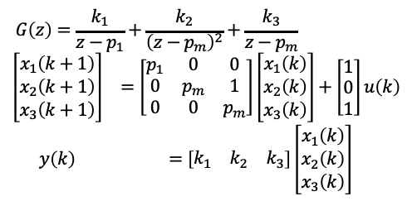
DT Jordan form 1
$$G\left(z\right)=\frac{b_{2}z^{2}+b_{1}z+b_{0}}{z^{3}+a_{2}z^{2}+a_{1}z+a_{0}}$$
Jordan form (2 repeated poles):
$$G\left(z\right)=\frac{k_{1}}{z−p_{1}}+\frac{k_{2}}{{\left(z−p_{m}\right)}^{2}}+\frac{k_{3}}{z−p_{m}}$$
$$\begin{matrix}\left[\begin{matrix}x_{1}\left(k+1\right) \\ x_{2}\left(k+1\right) \\ x_{3}\left(k+1\right)\end{matrix}\right] & =\left[\begin{matrix}p_{1} & 0 & 0 \\ 0 & p_{m} & 1 \\ 0 & 0 & p_{m}\end{matrix}\right]\left[\begin{matrix}x_{1}\left(k\right) \\ x_{2}\left(k\right) \\ x_{3}\left(k\right)\end{matrix}\right]+\left[\begin{matrix}1 \\ 0 \\ 1\end{matrix}\right]u\left(k\right) \\ y\left(k\right) & =\left[\begin{matrix}k_{1} & k_{2} & k_{3}\end{matrix}\right]\left[\begin{matrix}x_{1}\left(k\right) \\ x_{2}\left(k\right) \\ x_{3}\left(k\right)\end{matrix}\right]\end{matrix}$$
State-Space Canonical Forms

Slide 32
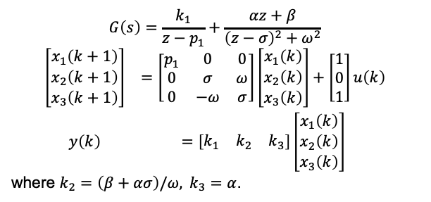
DT Jordan form 2
$$G\left(z\right)=\frac{b_{2}z^{2}+b_{1}z+b_{0}}{z^{3}+a_{2}z^{2}+a_{1}z+a_{0}}$$
Jordan form (2 complex poles):
$$G\left(s\right)=\frac{k_{1}}{z−p_{1}}+\frac{αz+β}{{\left(z−σ\right)}^{2}+ω^{2}}$$
$$\begin{matrix}\left[\begin{matrix}x_{1}\left(k+1\right) \\ x_{2}\left(k+1\right) \\ x_{3}\left(k+1\right)\end{matrix}\right] & =\left[\begin{matrix}p_{1} & 0 & 0 \\ 0 & σ & ω \\ 0 & −ω & σ\end{matrix}\right]\left[\begin{matrix}x_{1}\left(k\right) \\ x_{2}\left(k\right) \\ x_{3}\left(k\right)\end{matrix}\right]+\left[\begin{matrix}1 \\ 0 \\ 1\end{matrix}\right]u\left(k\right) \\ y\left(k\right) & =\left[\begin{matrix}k_{1} & k_{2} & k_{3}\end{matrix}\right]\left[\begin{matrix}x_{1}\left(k\right) \\ x_{2}\left(k\right) \\ x_{3}\left(k\right)\end{matrix}\right]\end{matrix}$$
where $k_{2}=\left(β+ασ\right)/ω, k_{3}=α$.
State-Space Canonical Forms

Slide 33
Exercise
obtain the controllable canonical form:
_{z}−1_{−z}−3
1+2z⁻¹+z⁻²
G (z) =
State-Space Canonical Forms

Slide 34
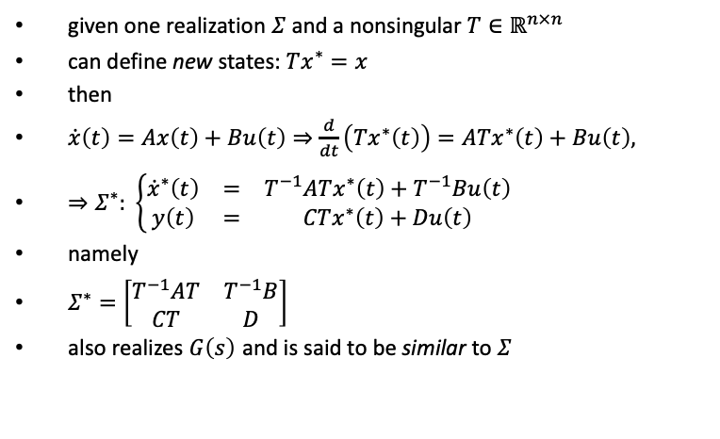
Relation between different realizations
given one realization $Σ$ and a nonsingular $T∈ℝ^{n×n}$
can define new states: $Tx^{∗}=x$
then
$\dot{x}\left(t\right)=Ax\left(t\right)+Bu\left(t\right)⇒\frac{d}{dt}\left(Tx^{∗}\left(t\right)\right)=ATx^{∗}\left(t\right)+Bu\left(t\right),$
$⇒Σ^{∗}: \left\{\begin{matrix}{\dot{x}}^{∗}\left(t\right) & = & T^{−1}ATx^{∗}\left(t\right)+T^{−1}Bu\left(t\right) \\ y\left(t\right) & = & CTx^{∗}\left(t\right)+Du\left(t\right)\end{matrix}\right.$
namely
$Σ^{∗}=\left[\begin{matrix}T^{−1}AT & T^{−1}B \\ CT & D\end{matrix}\right]$
also realizes $G\left(s\right)$ and is said to be similar to $Σ$
State-Space Canonical Forms

Slide 35
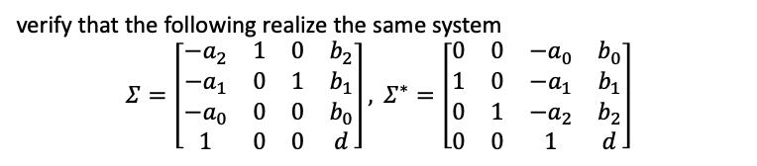
Relation between different realizations
verify that the following realize the same system
$$Σ=\left[\begin{matrix}−a_{2} & 1 & 0 & b_{2} \\ −a_{1} & 0 & 1 & b_{1} \\ −a_{0} & 0 & 0 & b_{0} \\ 1 & 0 & 0 & d\end{matrix}\right], Σ^{∗}=\left[\begin{matrix}0 & 0 & −a_{0} & b_{0} \\ 1 & 0 & −a_{1} & b_{1} \\ 0 & 1 & −a_{2} & b_{2} \\ 0 & 0 & 1 & d\end{matrix}\right]$$
State-Space Canonical Forms

